Slide 1
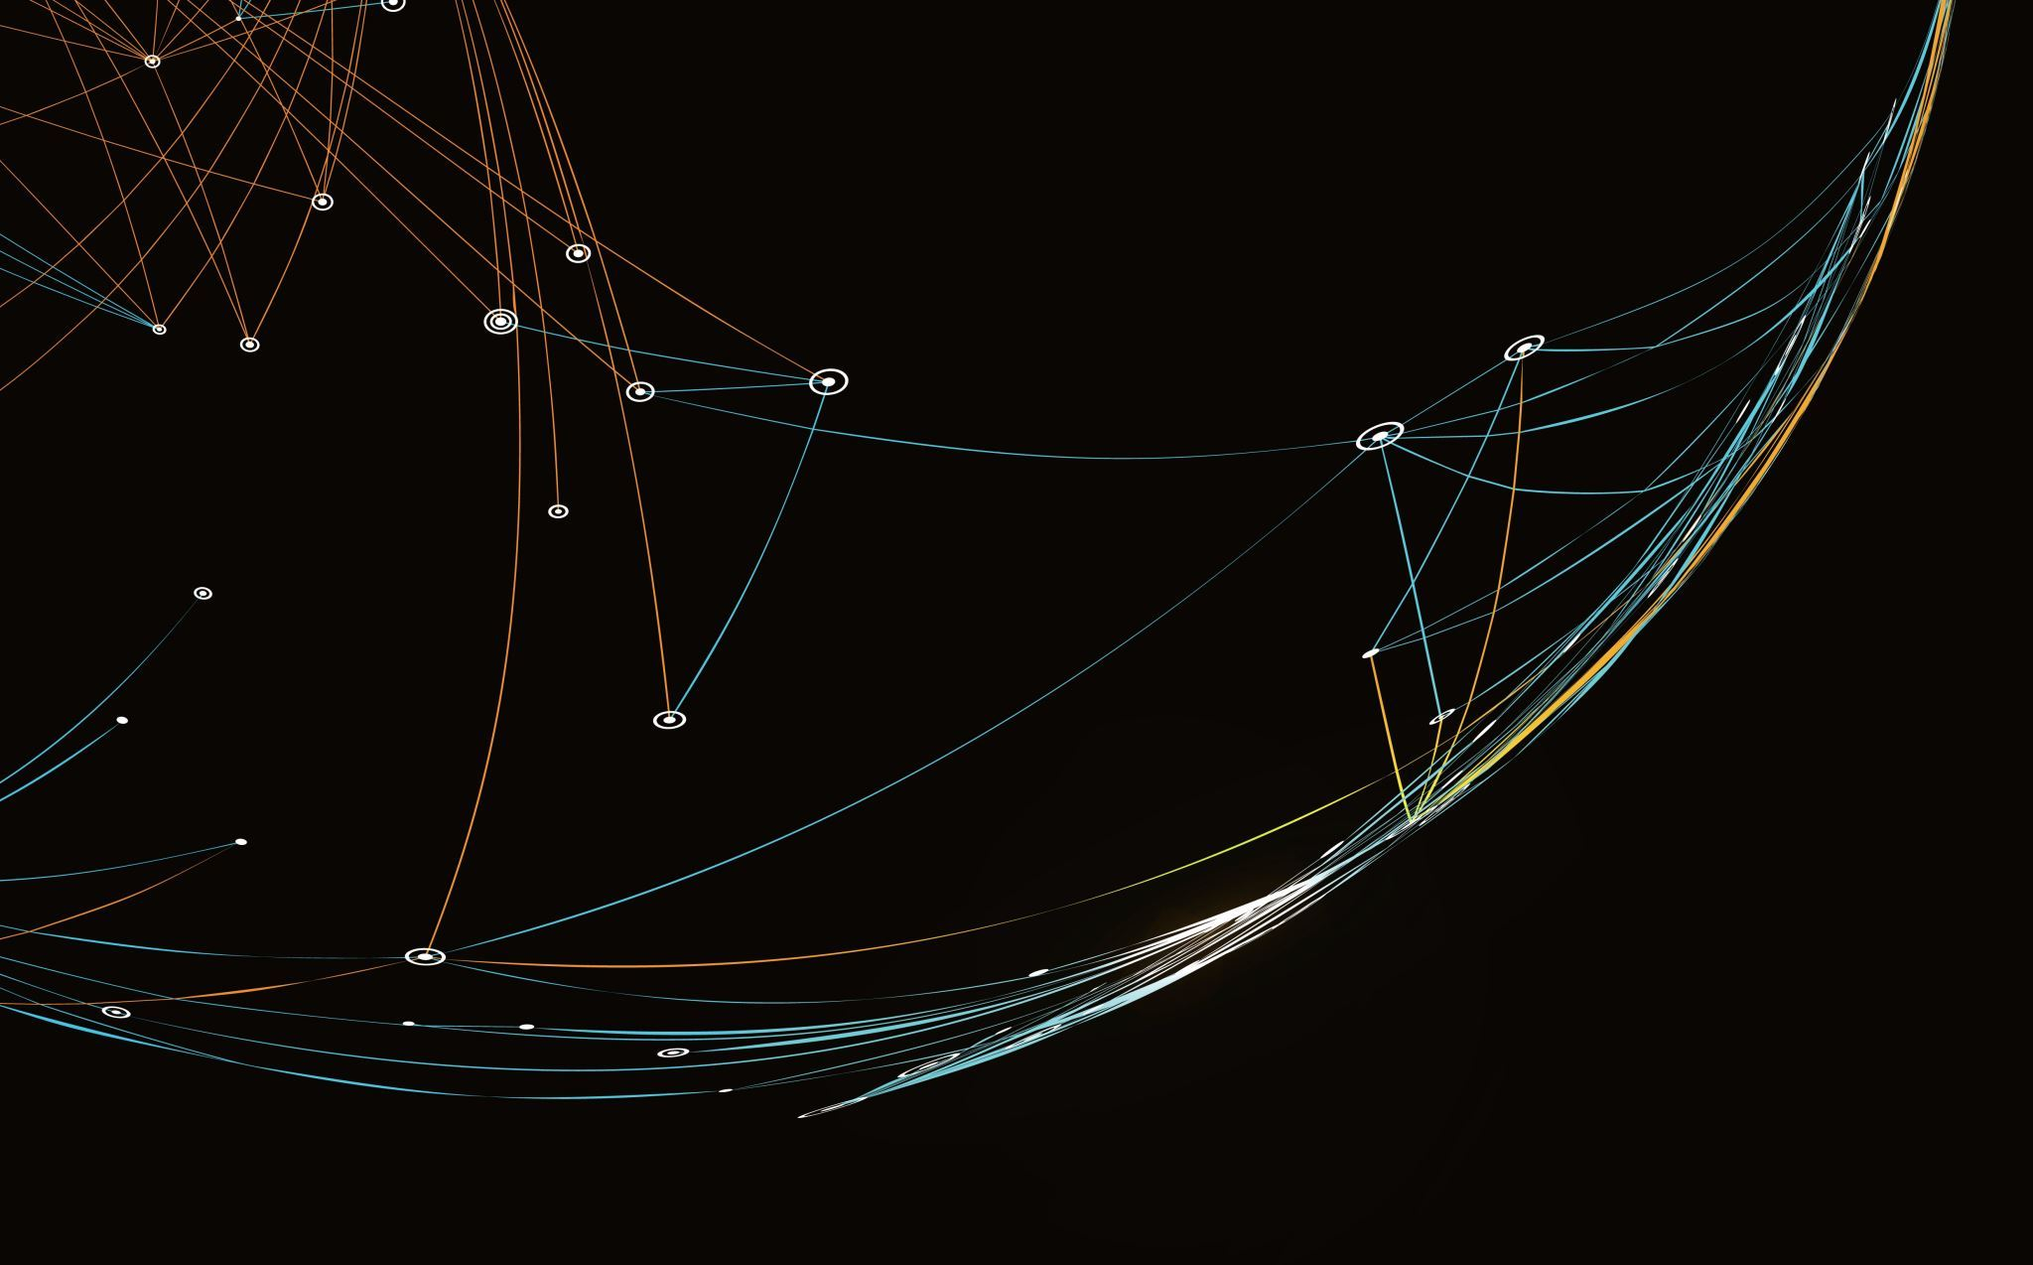
BookMe
Josh Lohner, Seth Beesley, Prosper Jibunor
1

Slide 2
Iteration Lines of Code
Josh Lohner (Front-End): 150
Seth Beesley(Back-End): 41
TLOC: 817
2

Slide 3
Test Coverage & Burndown Rate
Test Coverage: 10%
Burndown Rate: 20%
3

Slide 4
Current Milestones
Create/Finish concrete version of Login (Front-End)
Create/Finish concrete version of Login Database (Back-End)
4

Slide 5
Future Milestones
Create a usable messaging system (Front-End)
Finish on the Firebase Messaging system (Back-End)
5

